Slide 1

ORBITAL DEBRIS STUDY
Debris Cascades
in Low-Earth Orbit
How the debris population of low-Earth orbit evolves, what pushes it toward a Kessler cascade, and what holds it back. Traffic, disposal, removal and explosions run on the real catalog; a missile strike and a barrel of nails are added and weighed on the same scale.
Real catalog · CUDA propagation · NASA breakup model · three cascade engines

Slide 2
GROUNDED IN REAL DATA
The catalog we simulate
29,779
9,956
REAL OBJECTS · RADAR CROSS-SECTION
Object | RCS | Altitude
ISS (Zarya) | 399 m² | 416 km
Hubble | 28 m² | 470 km
Envisat · 8 t, dead | 19 m² | 761 km
SL-16 rocket body | 11 m² | ~850 km
tracked objects in LEO
catalogued debris pieces (+1,573 rocket bodies)
511 kg
4.4 m²
mean payload mass
mean payload cross-section
The environment: every catalogued object carries its own mass and area, from its radar cross-section where known (97%), alongside a modelled field of ~1,000,000 lethal 1–10 cm fragments too small for radar to track.

Slide 3
KEY TERMS
The vocabulary
Kessler syndrome / runaway
Supercritical
Catastrophic collision
A chain reaction: each collision makes debris that triggers more collisions, so the debris count keeps climbing on its own — even if every launch stopped today.
The tipping condition behind runaway: in a shell, collisions make fragments faster than drag removes them, so the population grows unaided.
An impact carrying ≥ 40 joules per gram of the target's mass — enough to shatter it, not just crater it.
NASA Standard Breakup Model
The belt (700–1,100 km)
≥10 cm objects
The standard empirical formula (Johnson et al., 2001) for how many fragments of each size a collision or explosion makes, from the objects' mass. Fit to real on-orbit events.
Where drag is weak and today's debris belt lives. The results track how its population changes over 50 years.
Big enough to track by radar and to shatter a small satellite — the standard metric of debris-evolution studies.
RCS (radar cross-section)
A/m & drag lifetime
Mission-kill
How big an object looks to tracking radar (m²) — used as its collision cross-section and to estimate mass.
Area-to-mass ratio sets how fast drag lowers an orbit: low orbits self-clean in years, high orbits persist for centuries.
An impact that disables a satellite without shattering it — leaving a dead hulk plus a little cratering debris.

Slide 4





THE TOOL
From the catalog to the cascade
Real catalog
CUDA propagation
Breakup model
Cascade engines
CelesTrak + Space-Track, per-object mass & RCS
J2 orbits on an RTX 5090, 177 M states/s
NASA Standard Breakup Model, 40 J/g threshold
Box ODE · discrete MC · conjunction geometry
Three independent engines, plus launch traffic, explosions, debris removal and an “operators retreat” feedback. The cube engine draws the scenario charts; the box model resolves the barrel-sized effects; the discrete engine checks both.

Slide 5
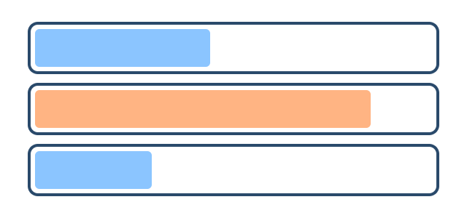
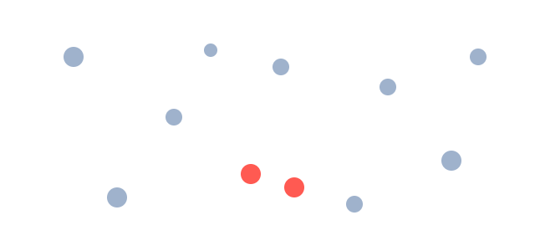
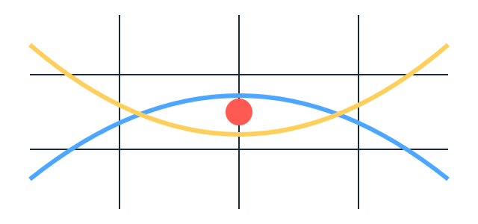
THE ENGINES
Three ways to model a cascade
Box · source–sink ODE
Discrete · super-particle MC
Conjunction · cube method
fast · aggregate
mid · per-object
high · real geometry (GPU)
Debris counts per altitude shell and size class, evolved by one equation. Well-mixed, no individuals.
Every object is an individual; collisions are drawn statistically, and fragments get real orbits that spread across shells.
Every object propagated on the GPU; a collision happens only where two orbits actually cross the same small cube.
Role: barrel-sized effects; cross-check.
Role: cross-check (8-seed ensembles).
Role: scenario charts (16-seed ensembles).

Slide 6
THE LANDSCAPE
Altitude is the whole story
1,200–1,500 km
Secondary persistent zone — even small fragments stay for centuries to millennia, and it is exactly where several proposed mega-constellations intend to operate.
The “bad neighborhood.” Fragments last a decade to two centuries, intact objects centuries: the real debris belt, home to dead giants like Envisat (8 t, 761 km). With no launches at all, its ≥10 cm population still grows ~9% in 50 years. NASA's LEGEND puts ~60% of future catastrophic collisions at 900–1,000 km (Liou & Johnson 2006).
700–1,100 km
200–600 km
Self-cleaning. Drag clears fragments in months to a few years and dead satellites in about a decade.
LEO is not one place: low orbit self-heals, high orbit is nearly permanent. Risk scales dramatically with altitude.

Slide 7
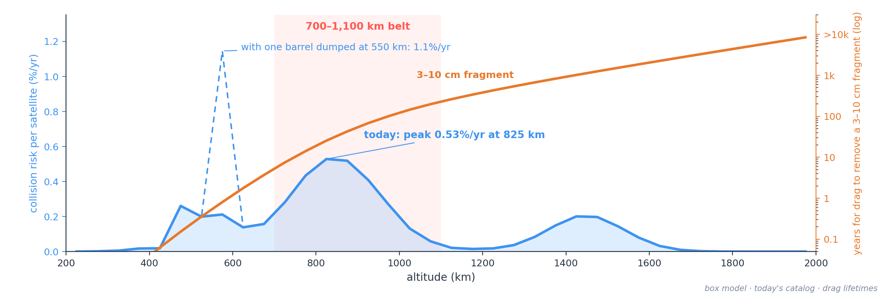
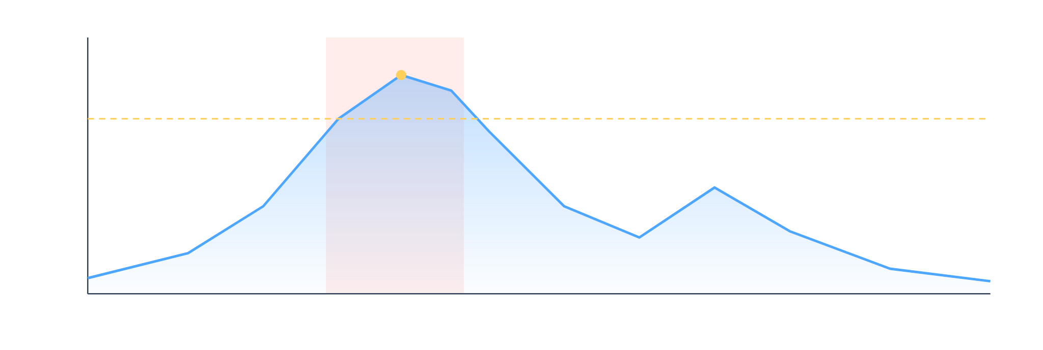
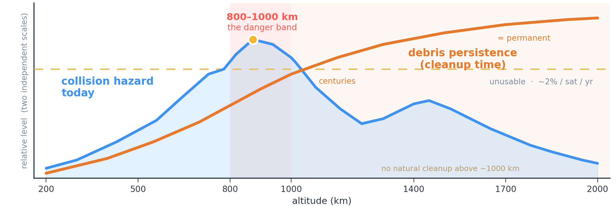
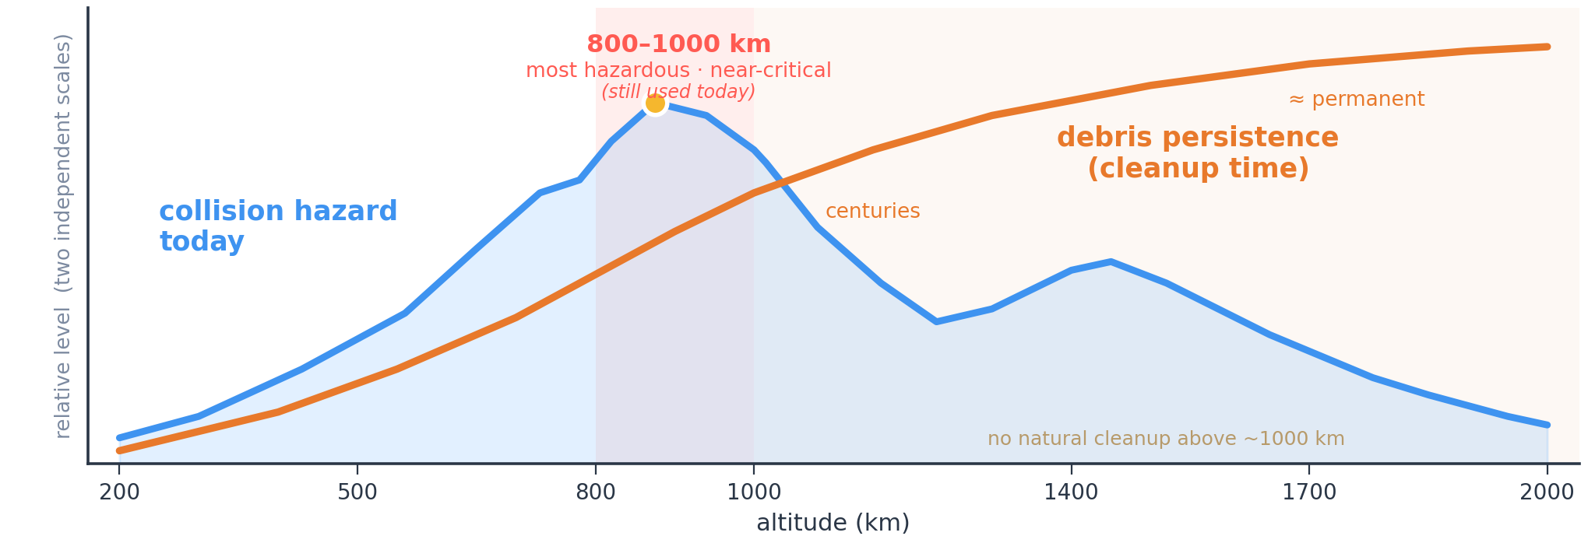
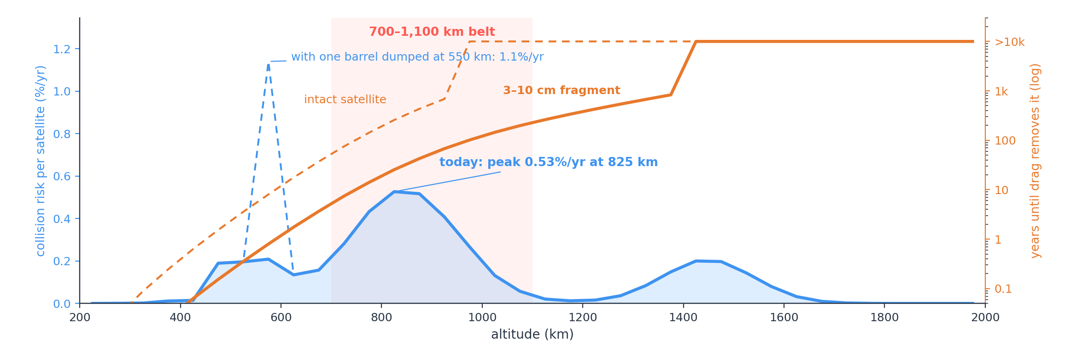

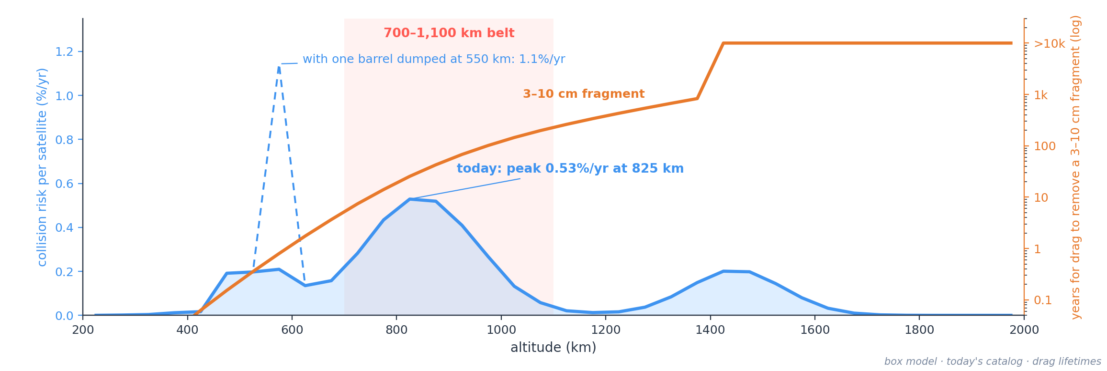
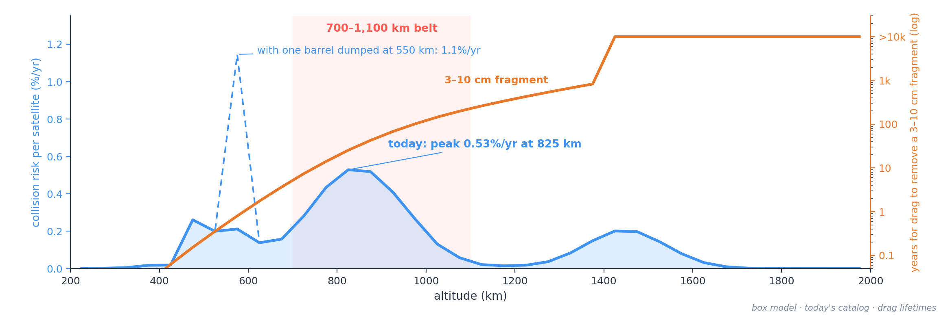
USABILITY BY ALTITUDE
Where the risk is — and how long it stays
Most hazardous — but not unusable.
A satellite in the 700–1,100 km belt runs a ~0.5% a year chance of a lethal hit today — the worst in LEO, but well below the ~2%/yr at which operators abandon a band. Orange is the deeper problem: above ~1,000 km even small fragments stay for centuries, so whatever breaks there doesn't clear. Added at 550 km, a barrel of nails briefly makes its shell the most dangerous in LEO (~1.1%/yr, 5× normal).

Slide 8
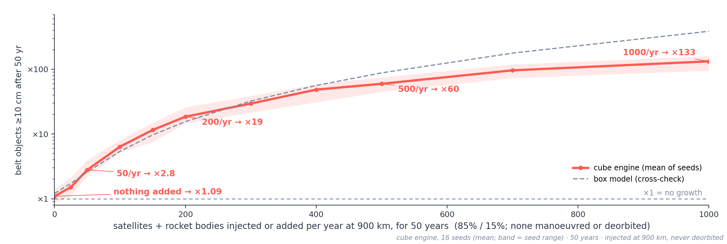
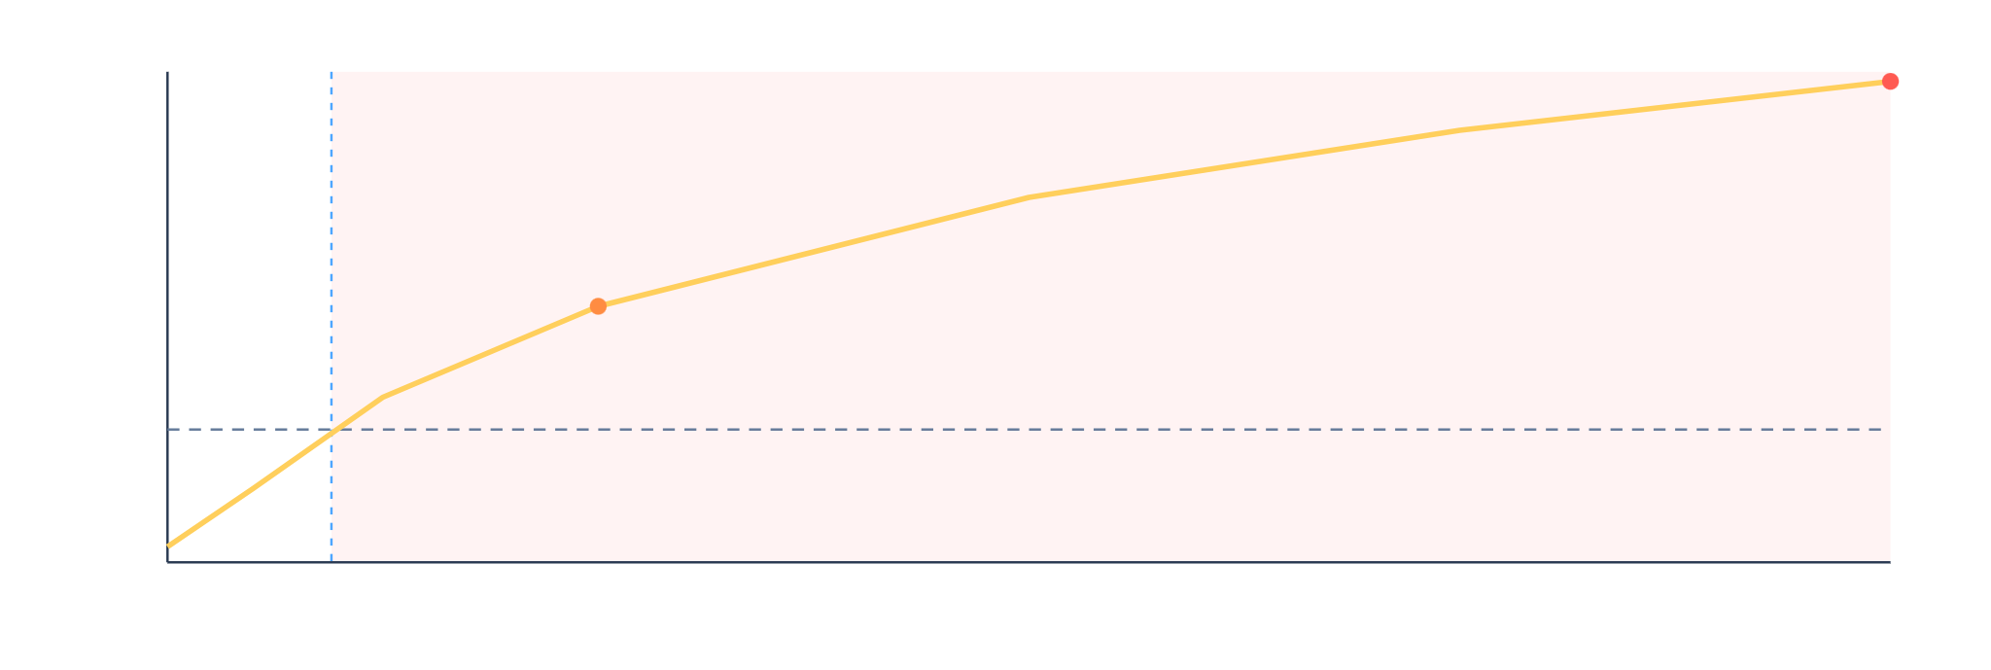
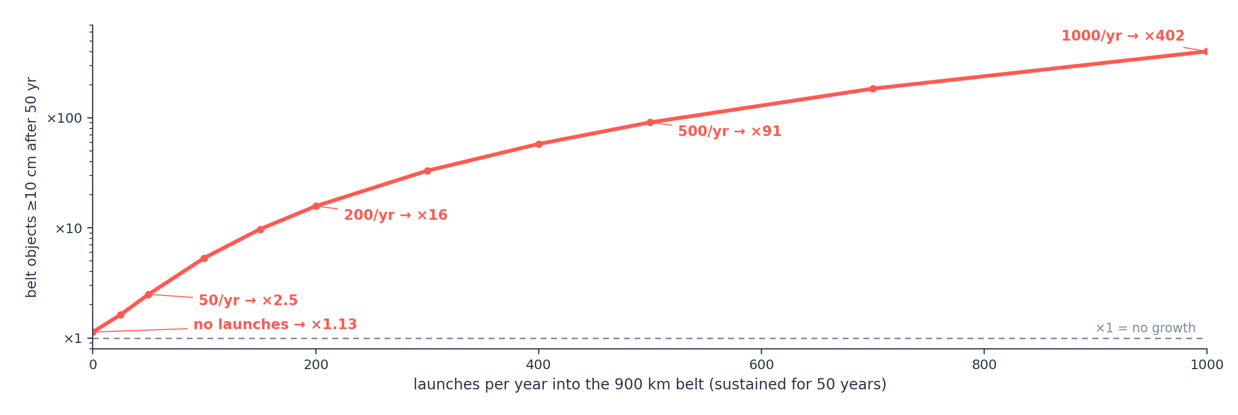
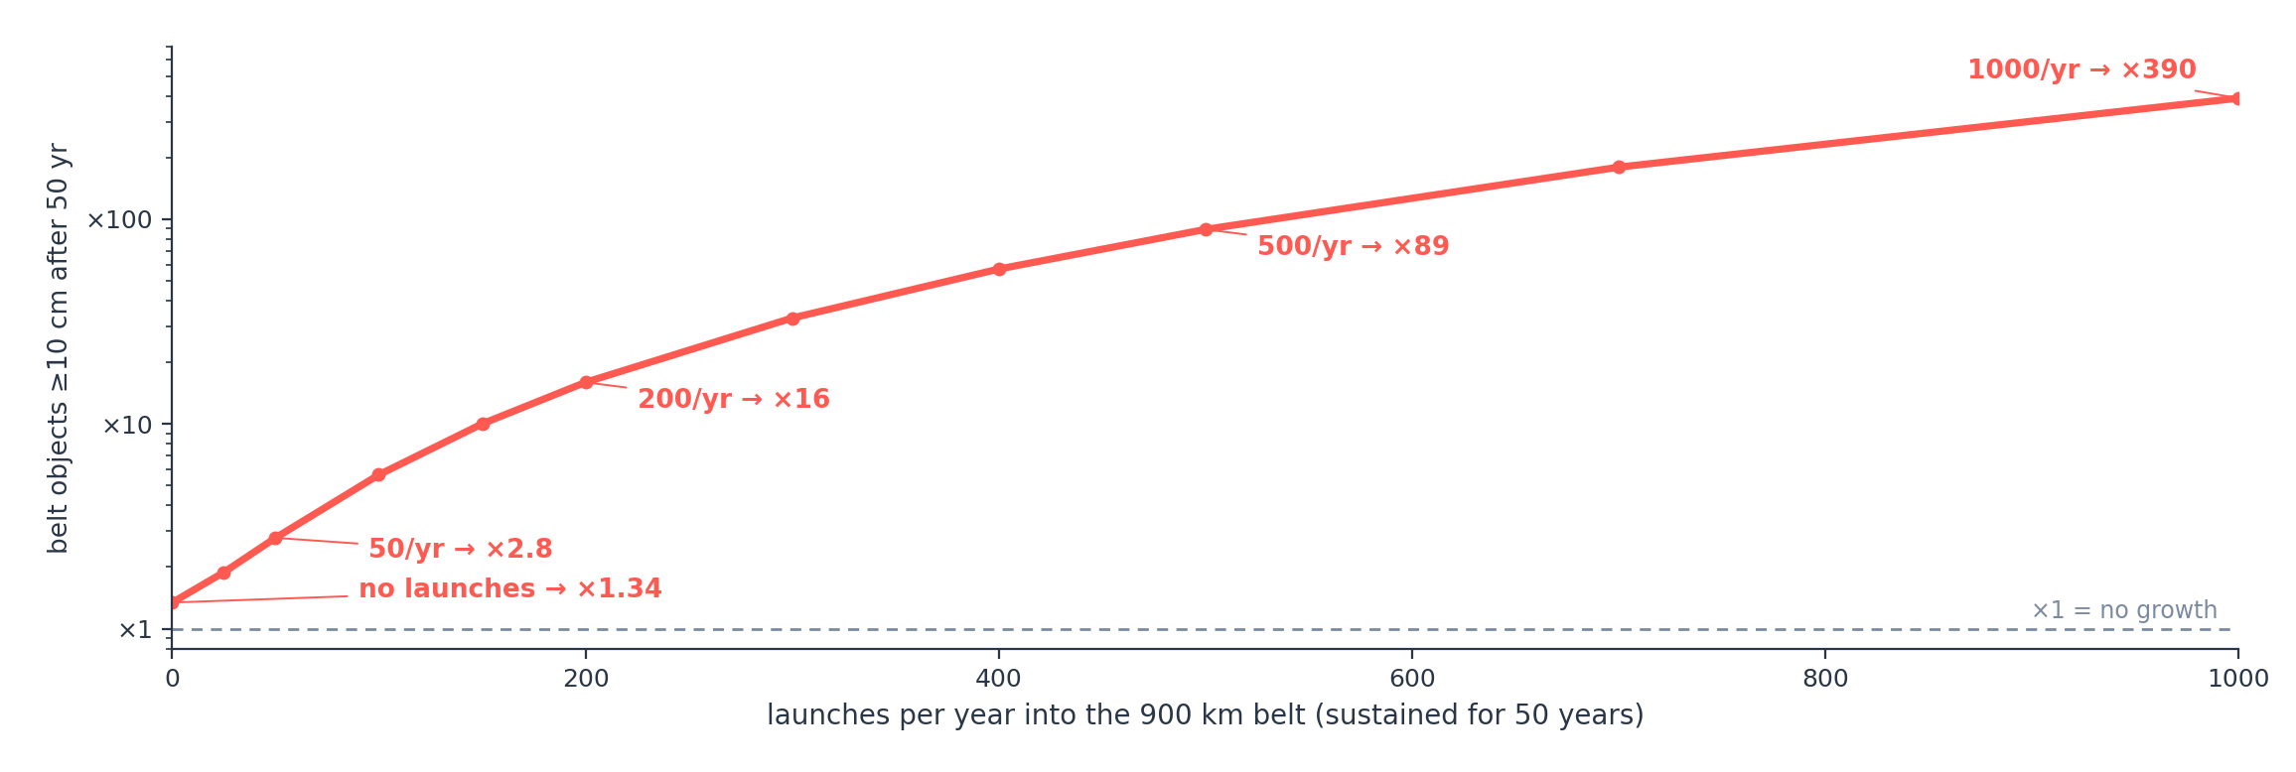
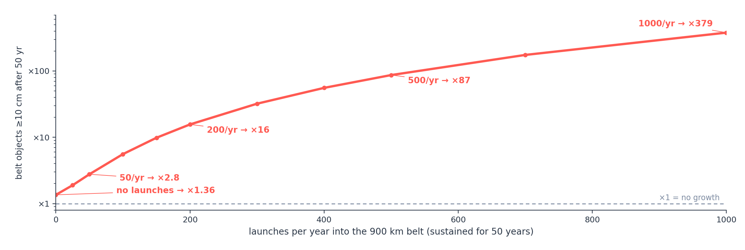
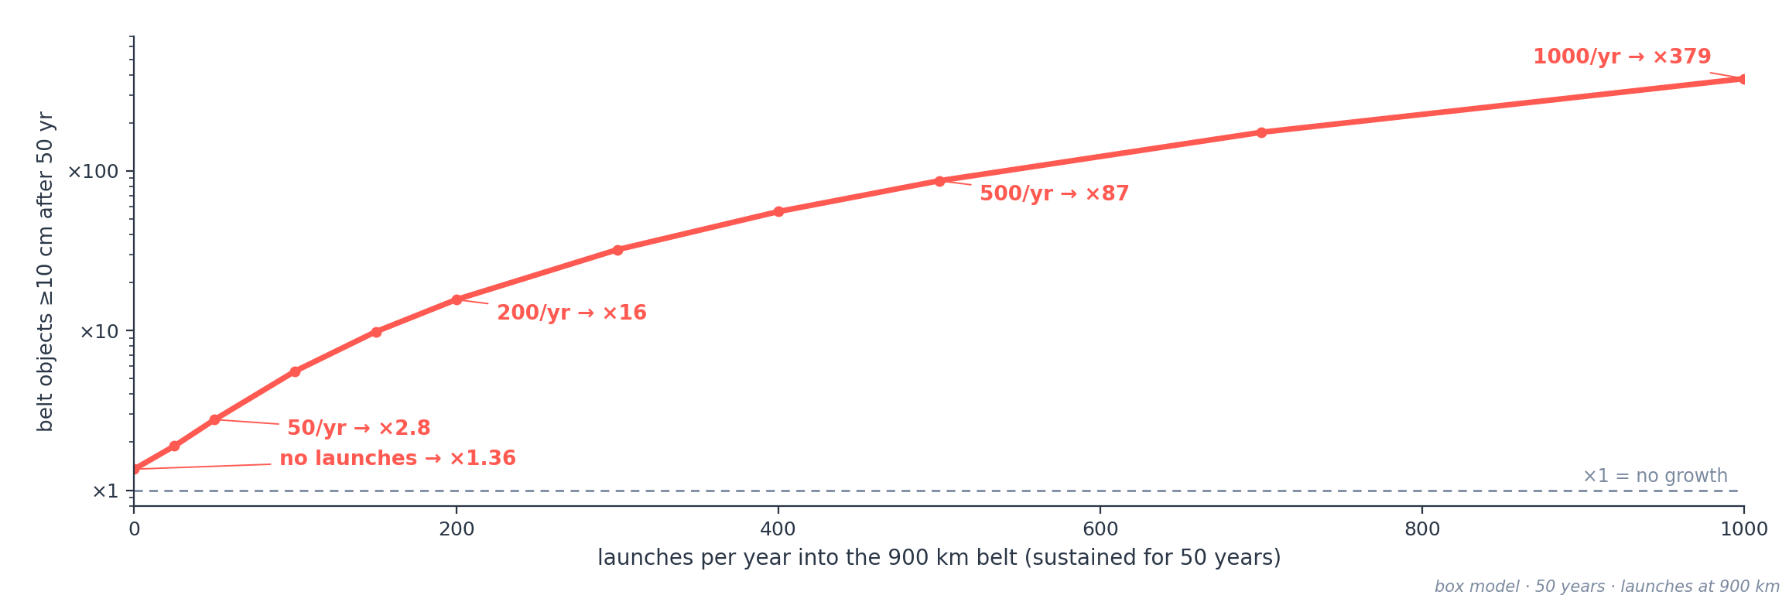
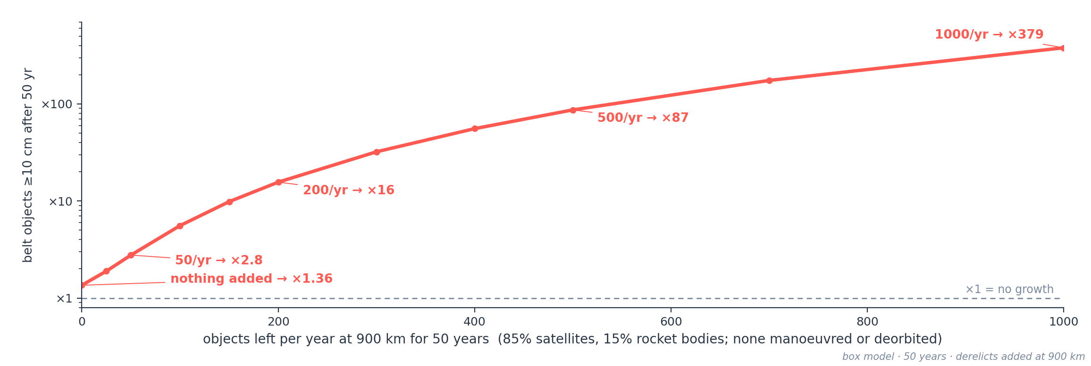
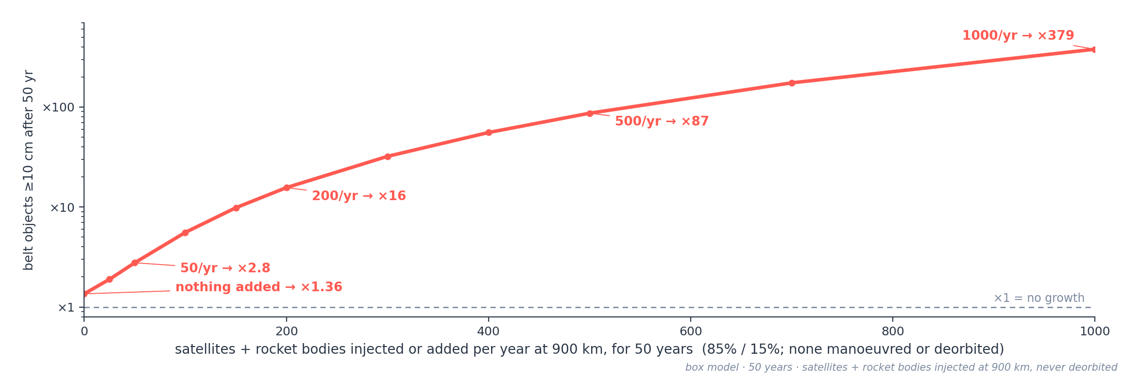
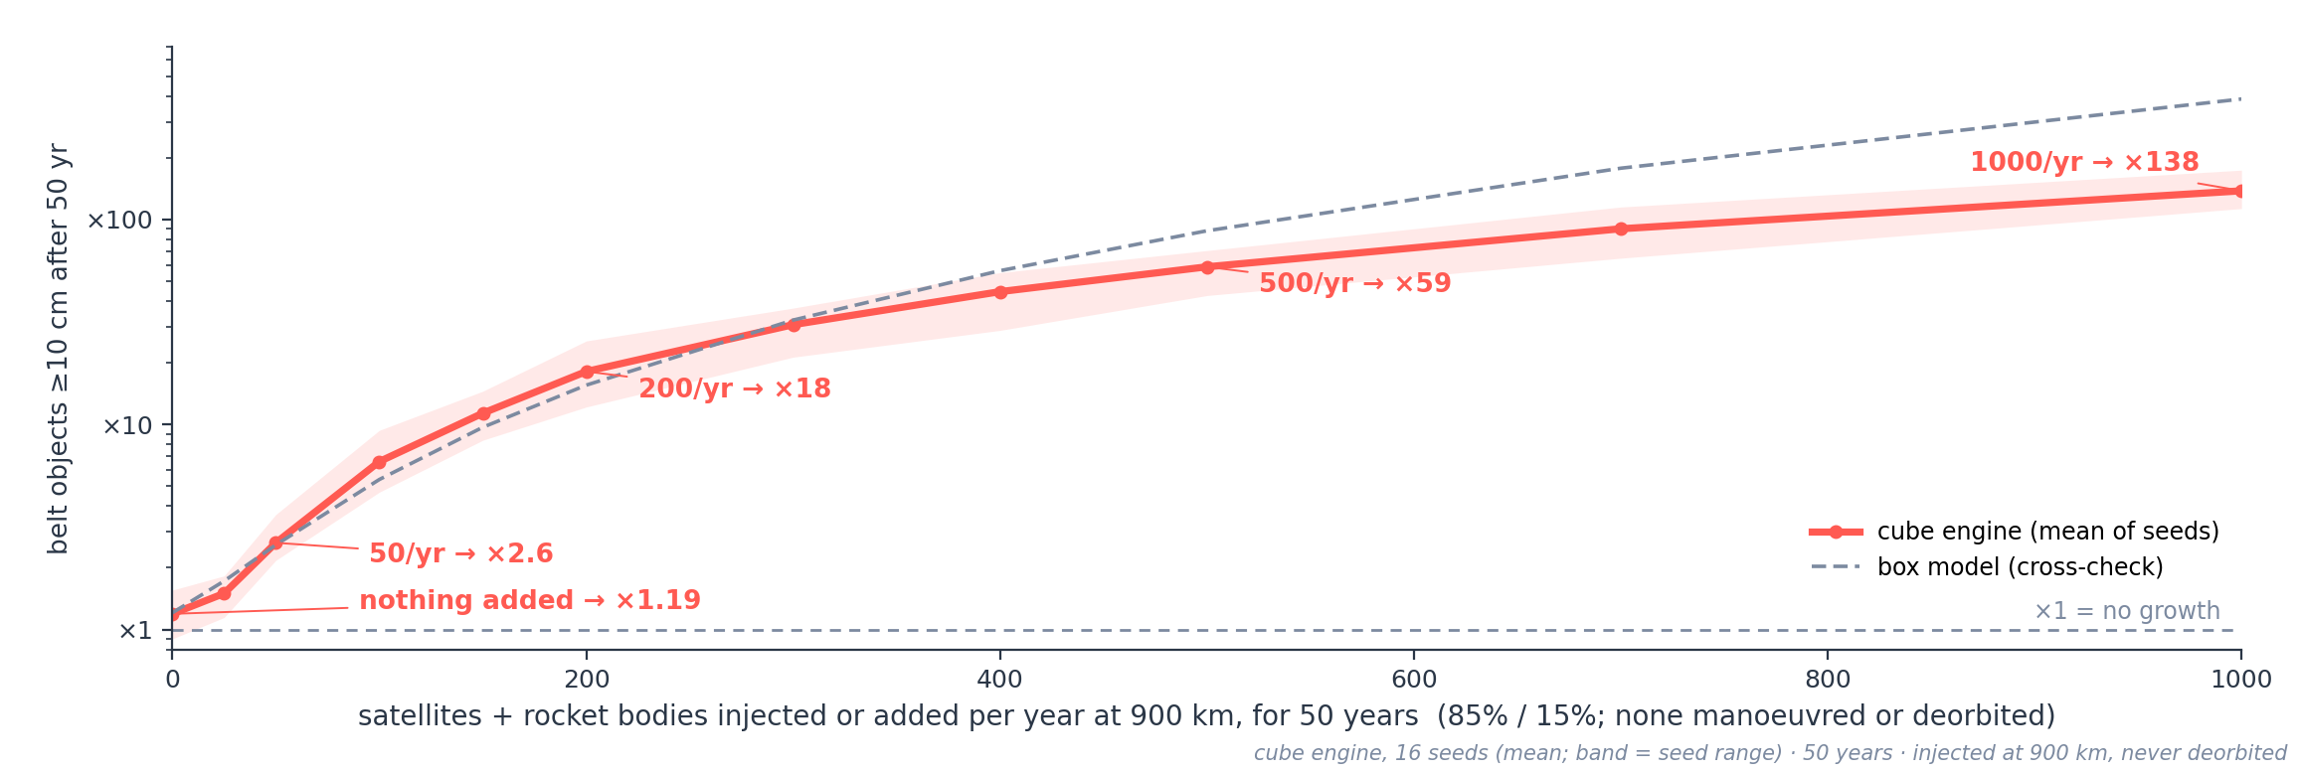
THE DRIVER · TRAFFIC
Injected satellites and rocket bodies drive the belt
Runaway = the debris population grows without ever settling.
Collisions and explosions breed fragments faster than drag can remove them, so more debris drives more collisions — a self-feeding cascade (Kessler syndrome). The belt is already there: with nothing added, its ≥10 cm population grows ~9% in 50 years. Each satellite or rocket body injected or added to it steepens that: 50 a year ×2.8, 200 a year ×19. None is ever manoeuvred or deorbited, and all sit at 900 km — a stress test, not a traffic forecast. Cube engine, mean of 16 seeds; cross-check at 50/yr: box ×2.6, discrete ×2.0 (8 seeds).

Slide 9
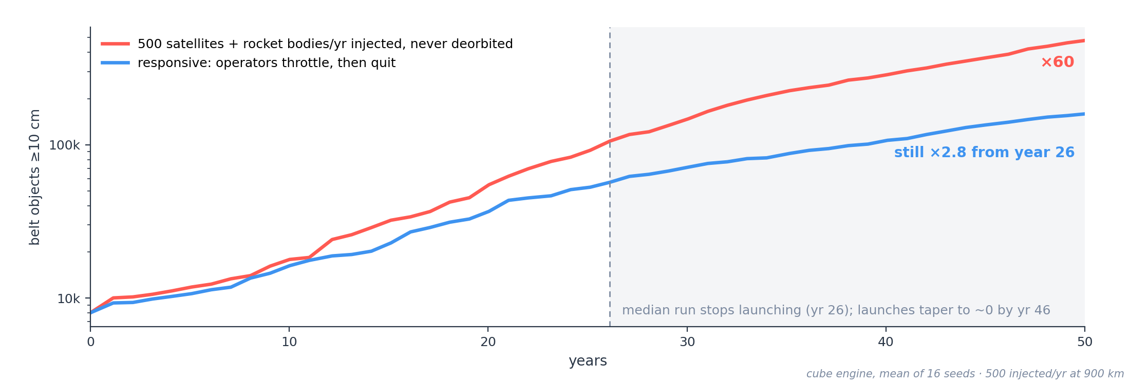
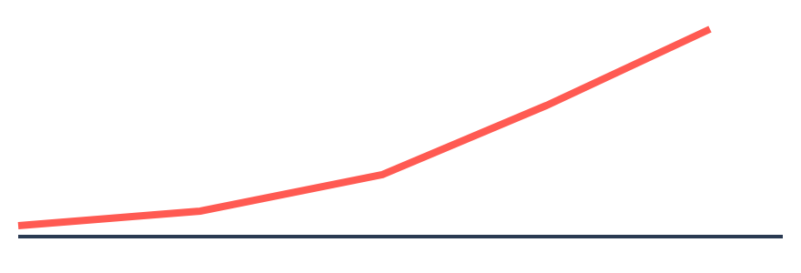
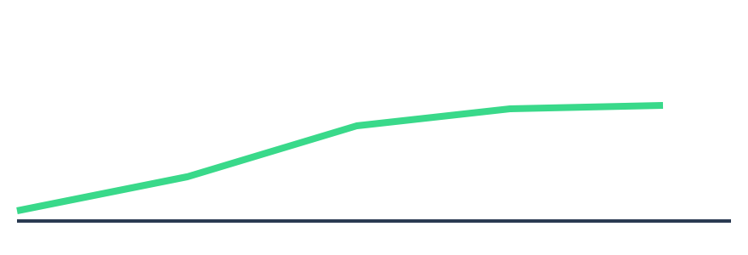
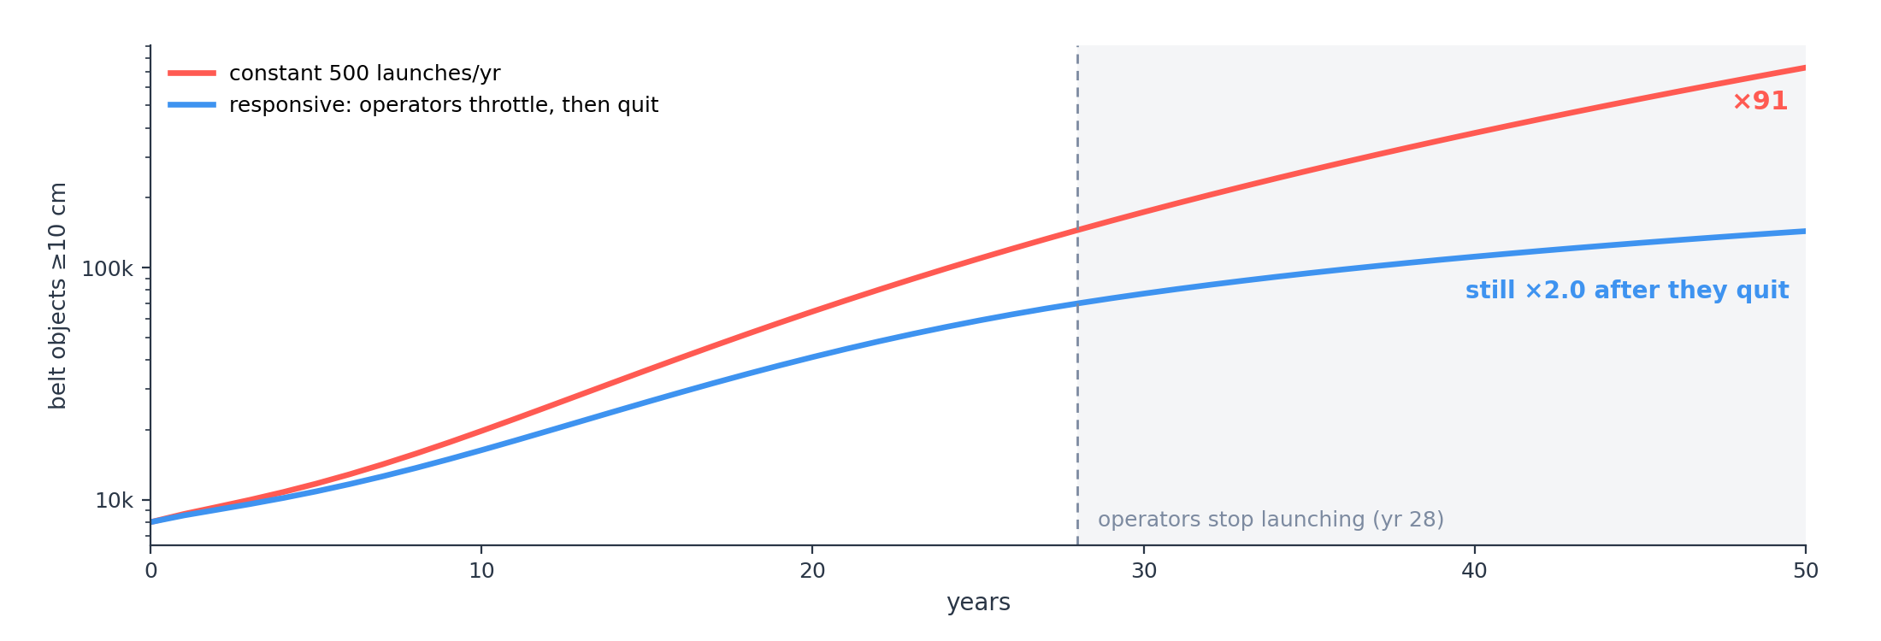


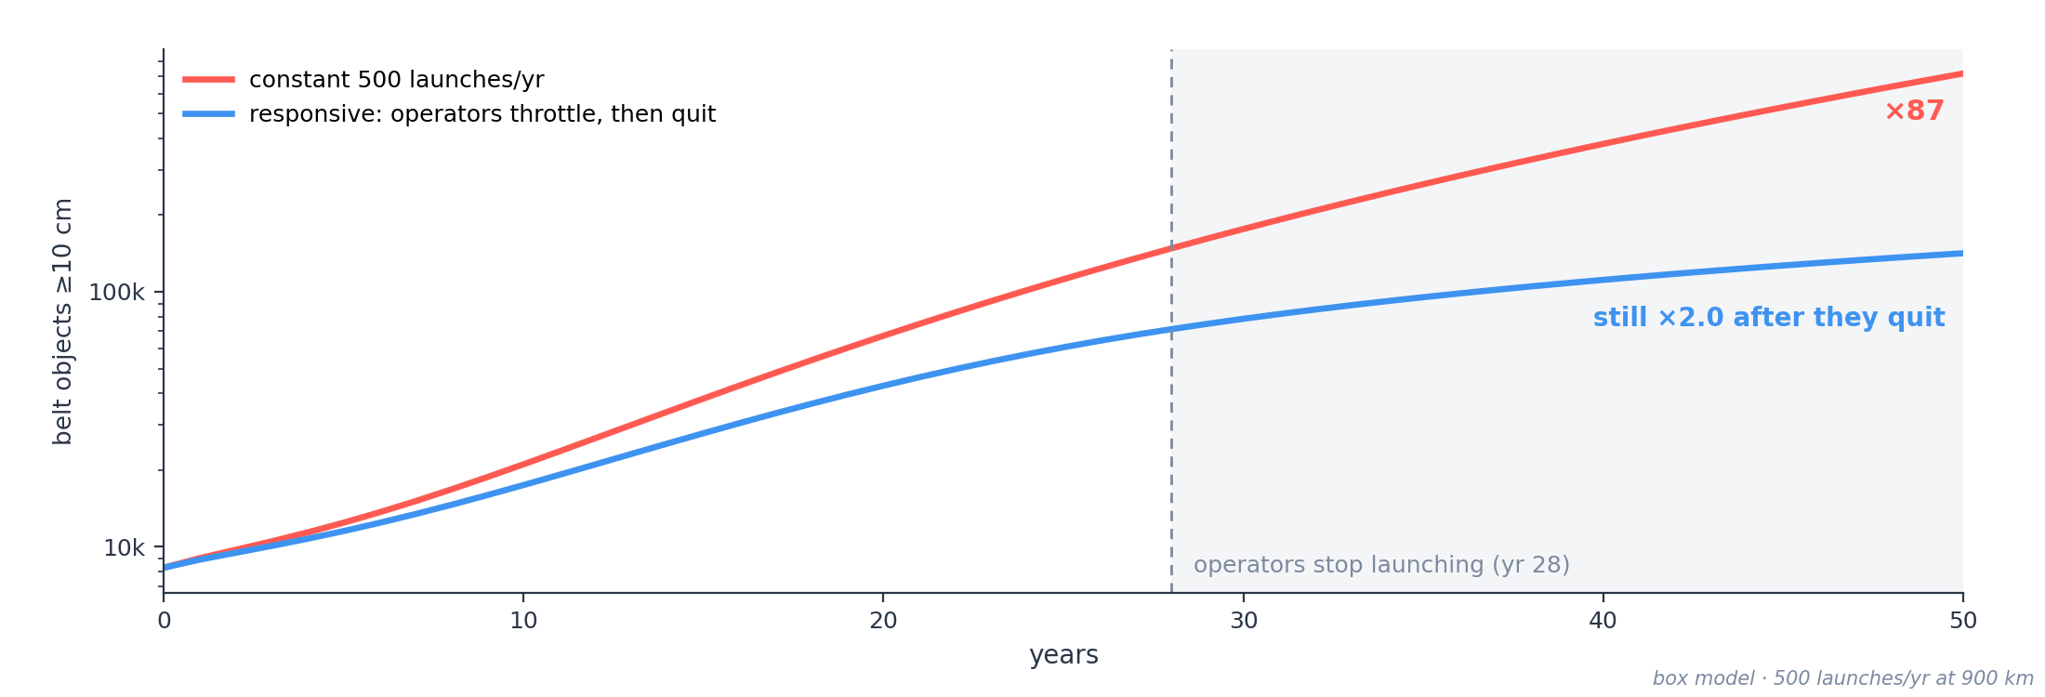
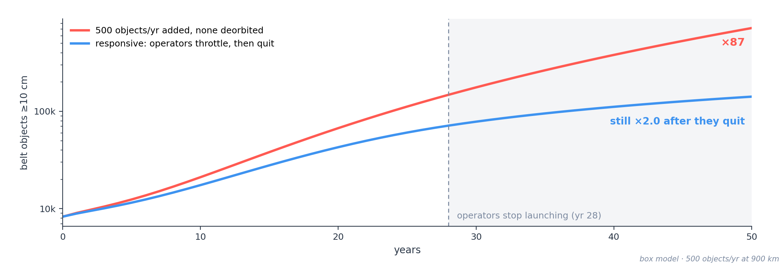
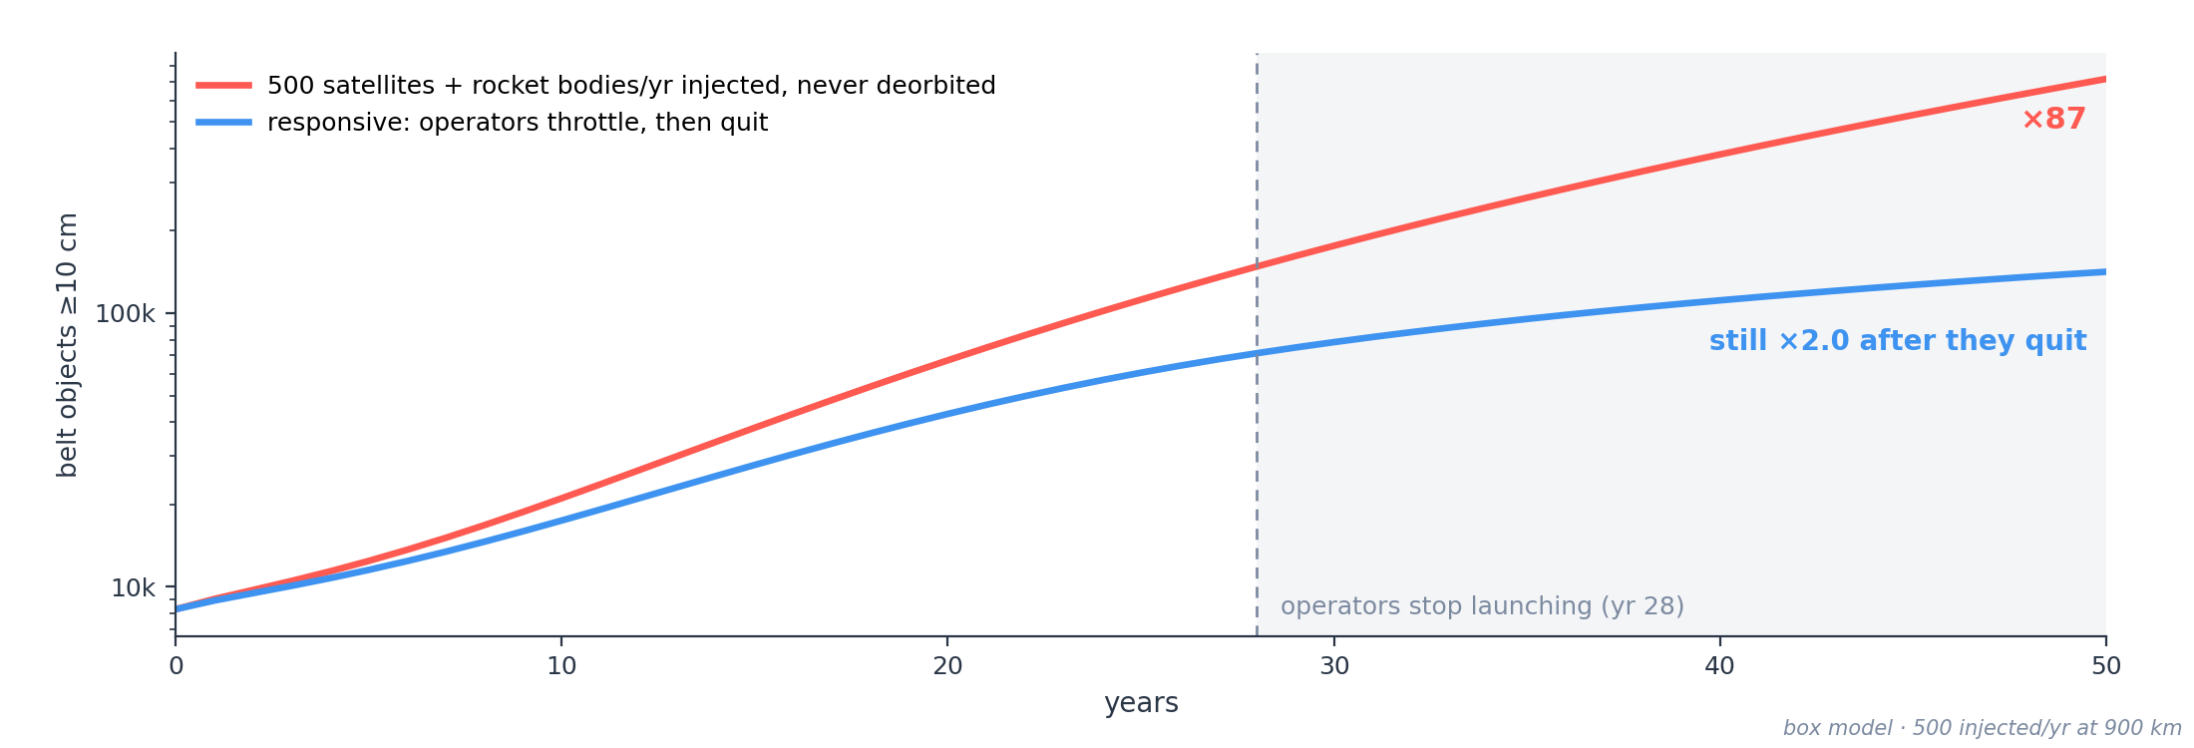
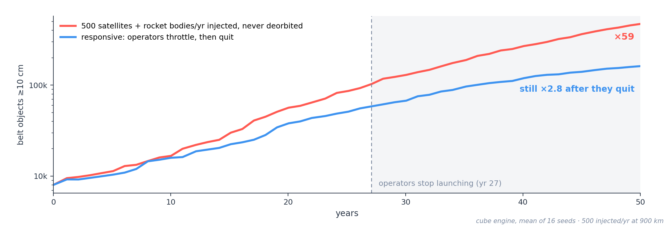
THE DRIVER · RATIONAL OPERATORS
Operators quit — the cascade doesn't
With 500 satellites and rocket bodies a year injected into the belt (none ever deorbited), operators throttle back as the risk rises: the median run stops launching by year ~26, and launches taper to almost nothing by year ~46. Yet the belt's ≥10 cm population still grows ×2.8 from year 26 on. Abandoning a band doesn't save it once the cascade runs.

Slide 10
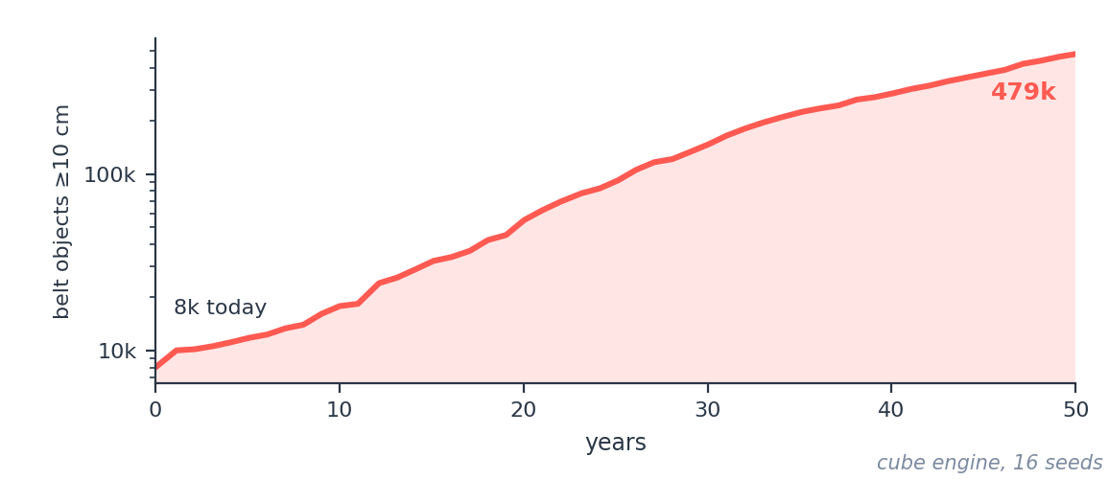
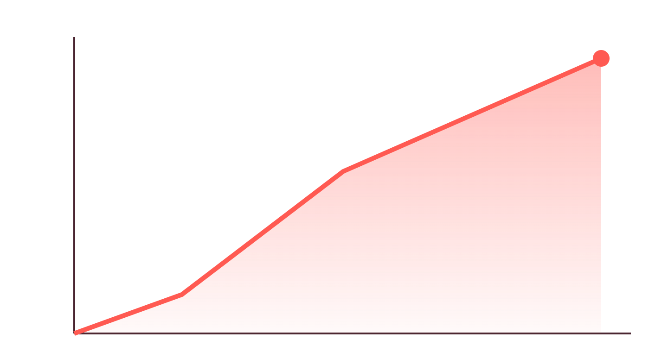
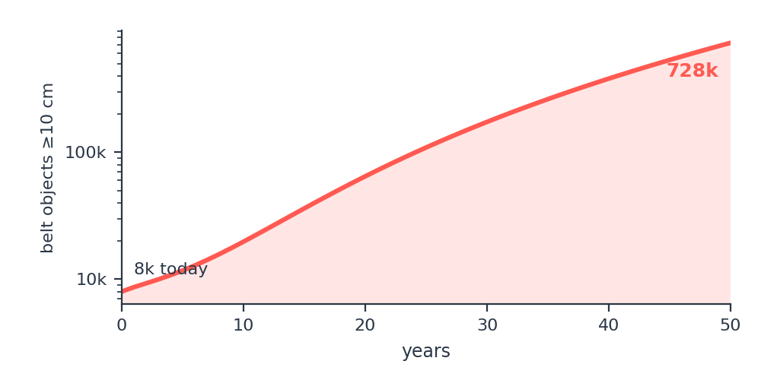
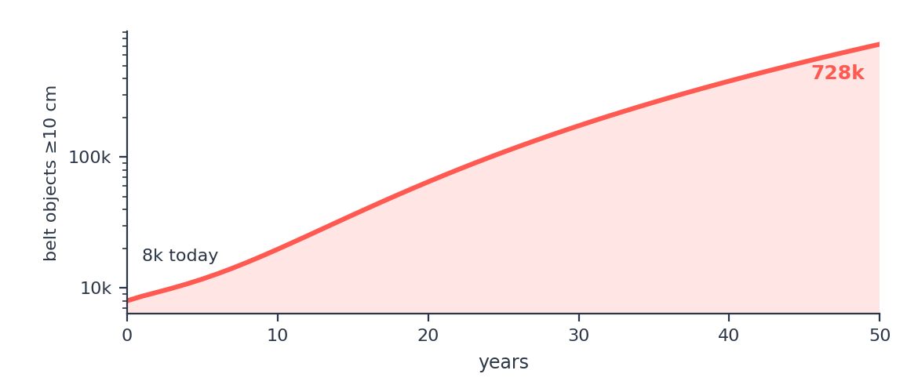
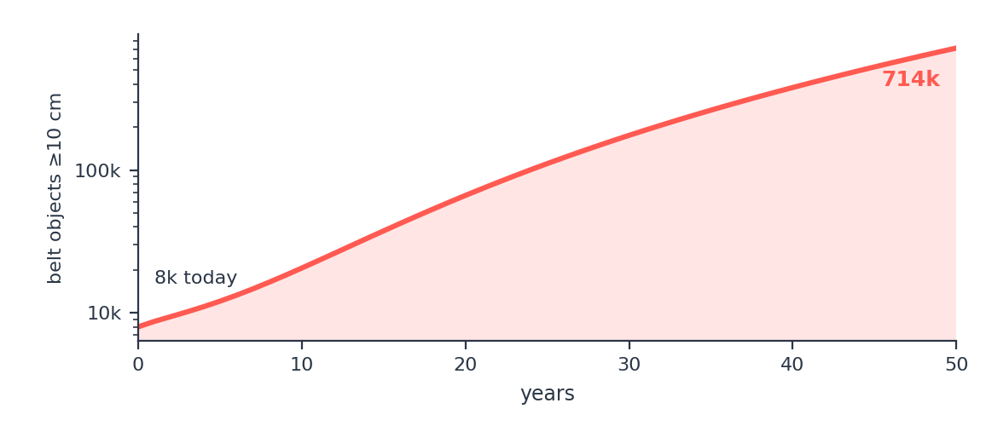

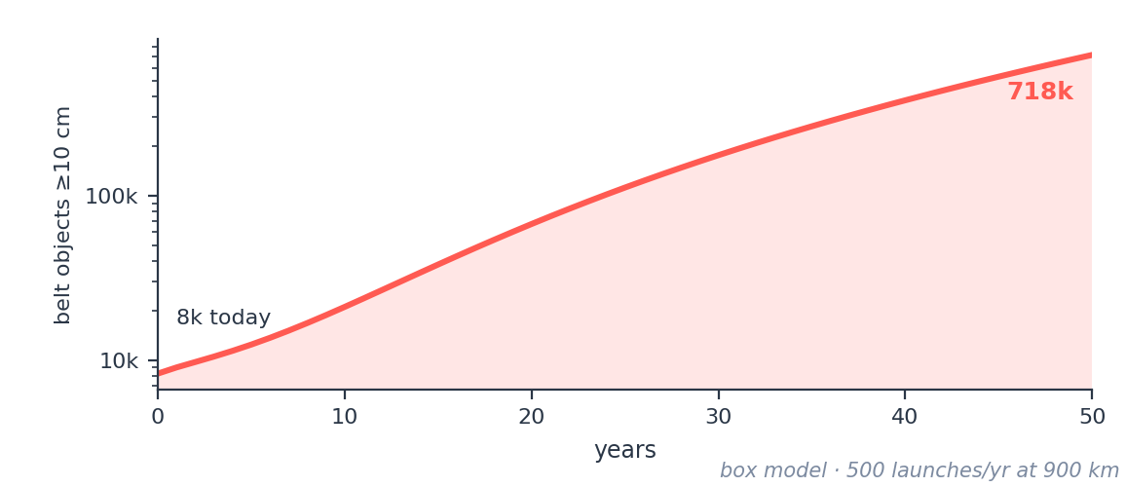
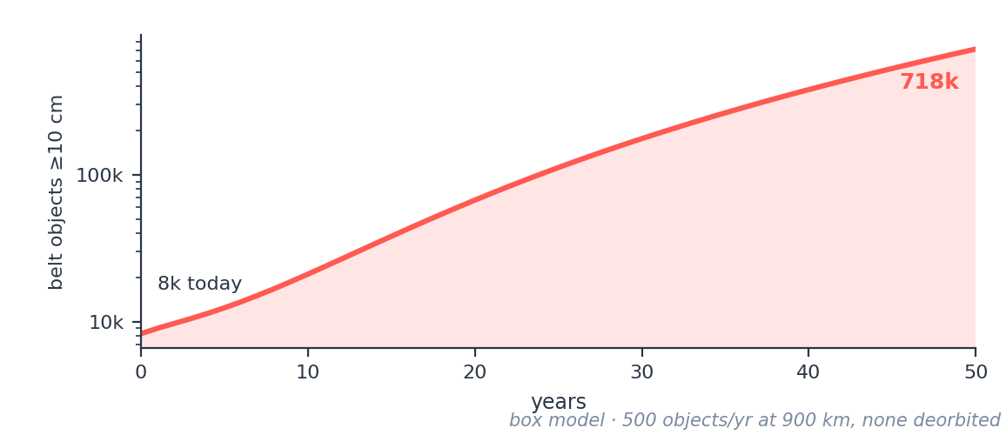
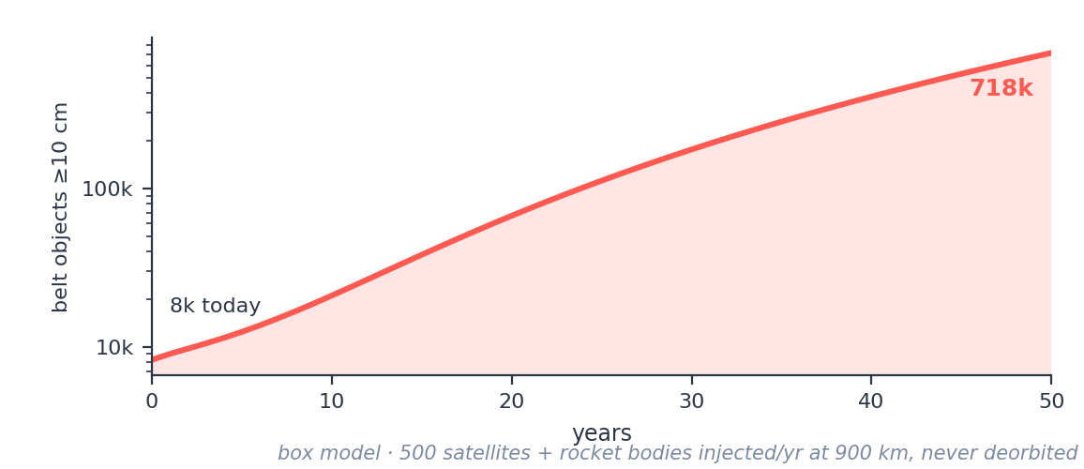
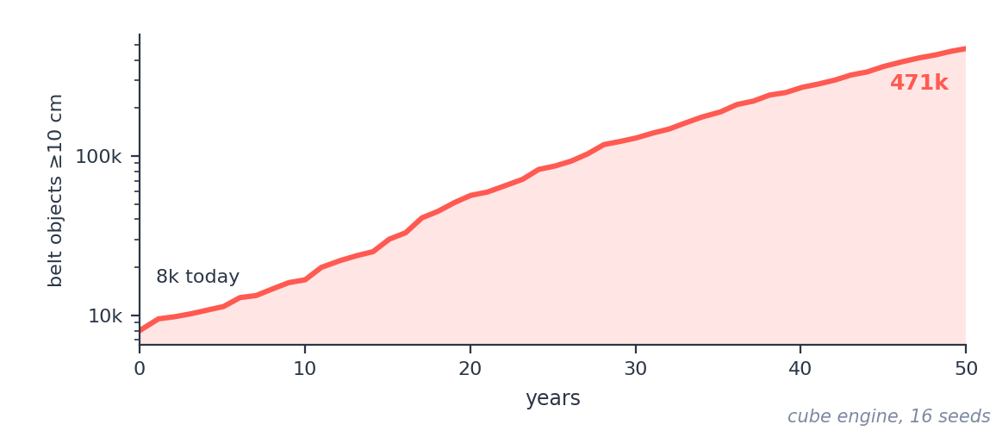
THE DRIVER · THE EXTREME CASE
What it would actually take to break LEO
Objects ≥10 cm in the 700–1,100 km belt, 50 years
~280 / yr
catastrophic collisions by year 50, incl. 1–10 cm impactors
×60
growth in objects ≥10 cm (8k → 479k)
Trigger: ~425 satellites + 75 rocket bodies injected a year for 50 years, never deorbited. No ASAT.
It takes mass and catastrophic energy — large objects, not nails. One ASAT strike on a 1 t satellite makes ~50,000 fragments ≥1 cm; the extreme is 500 satellites and rocket bodies a year piling into a band that already grows on its own. A nail has neither the mass nor the energy. Adding a barrel on top changes the belt by under 0.1%. The collision count includes 1–10 cm fragments shattering small objects, which NASA's LEGEND model leaves out: it counts ≥10 cm objects only.

Slide 11
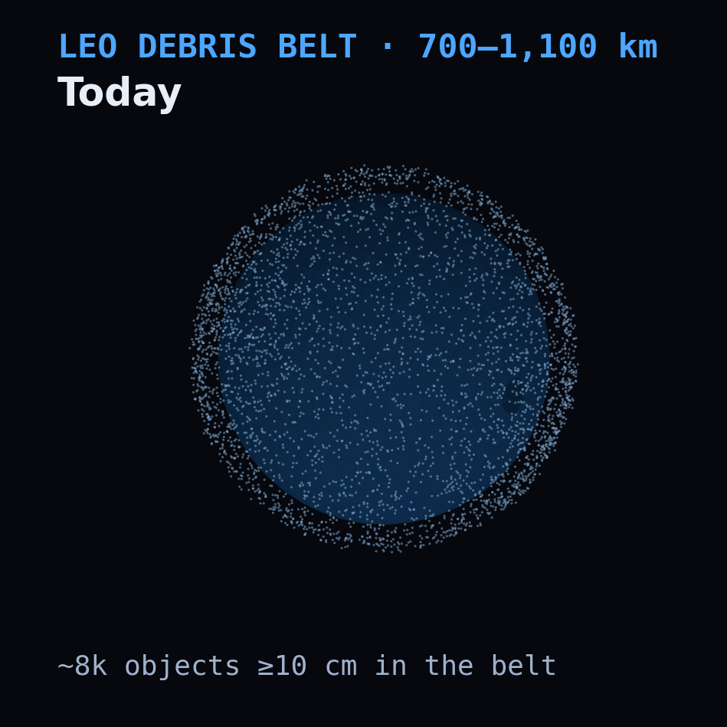
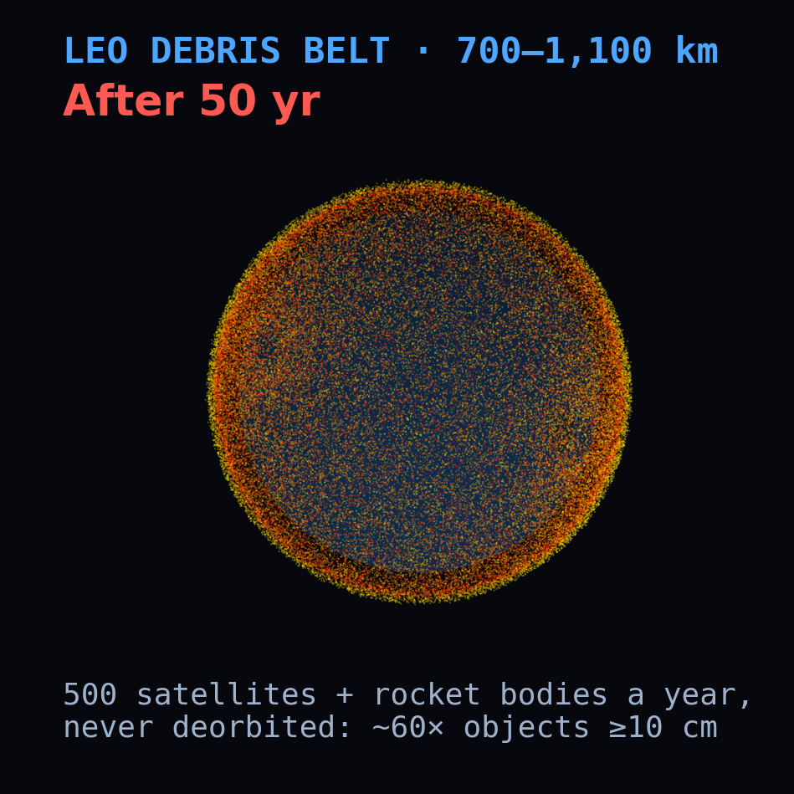
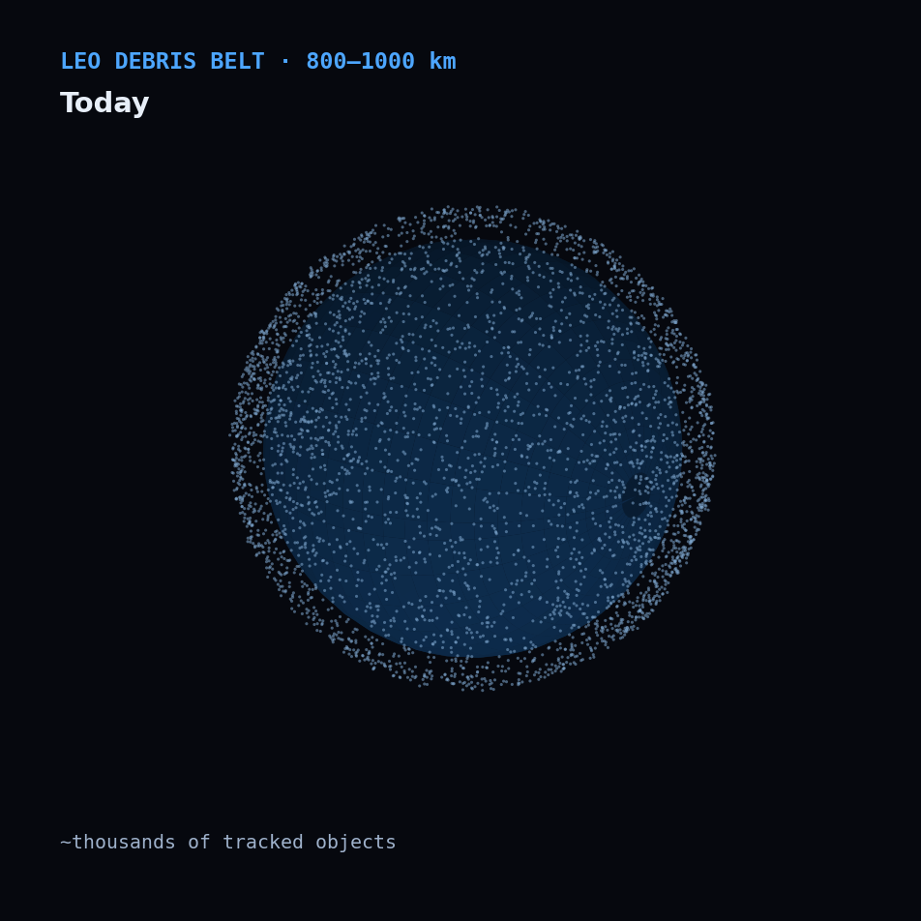
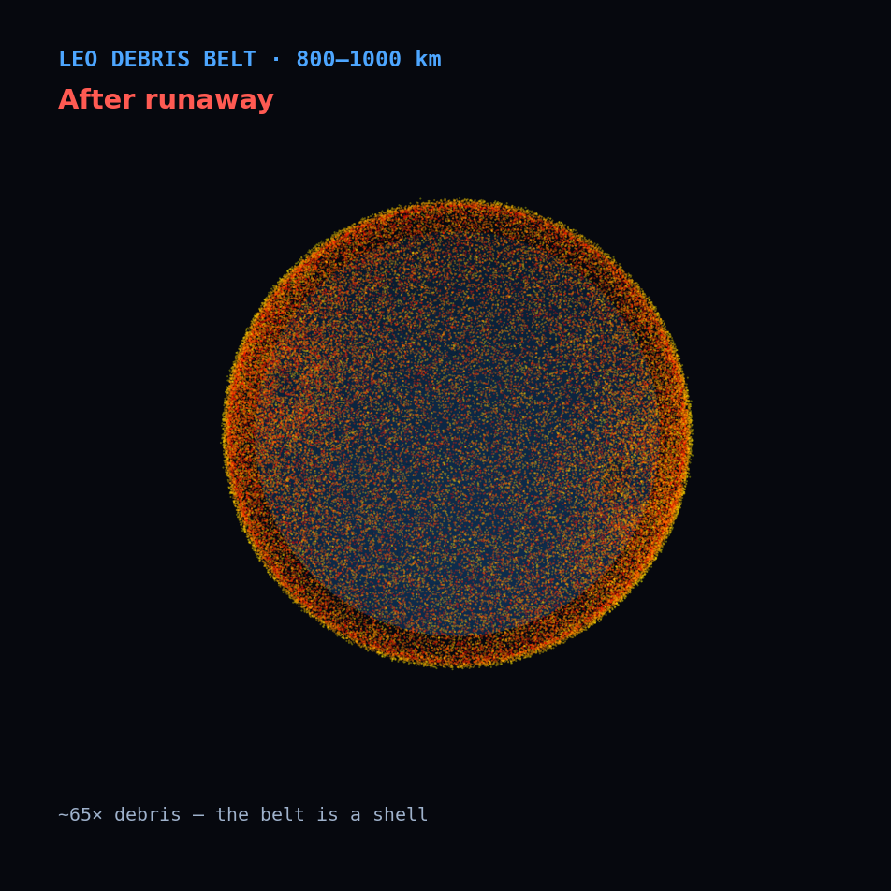
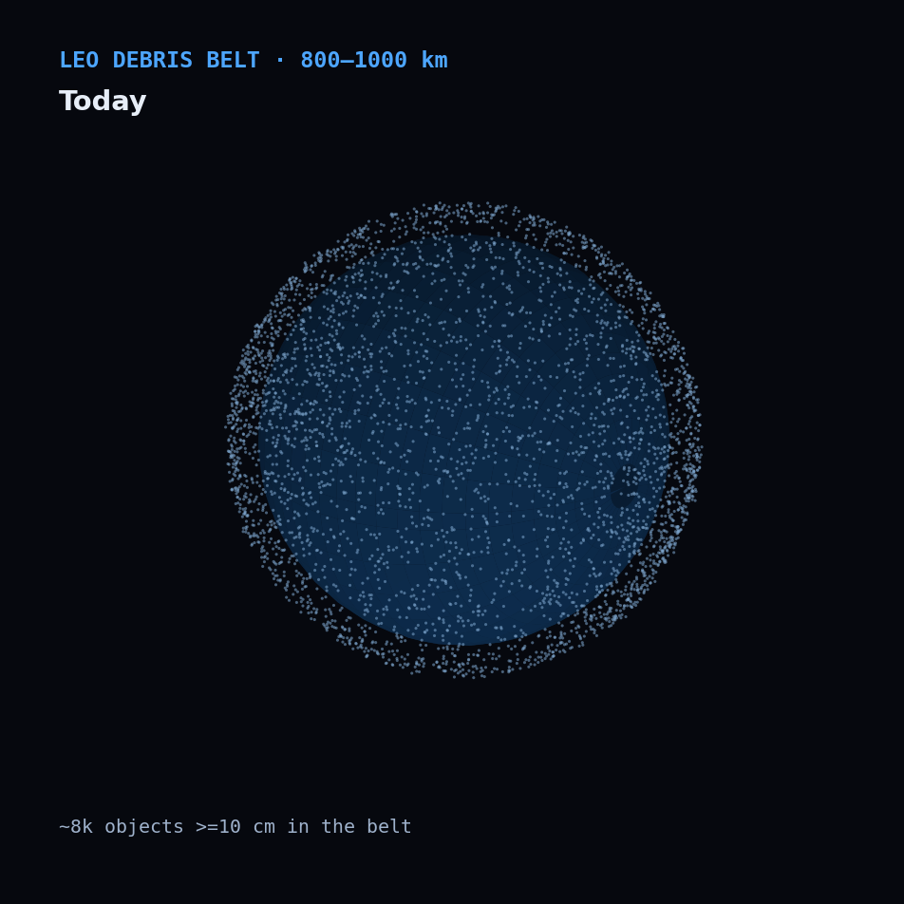
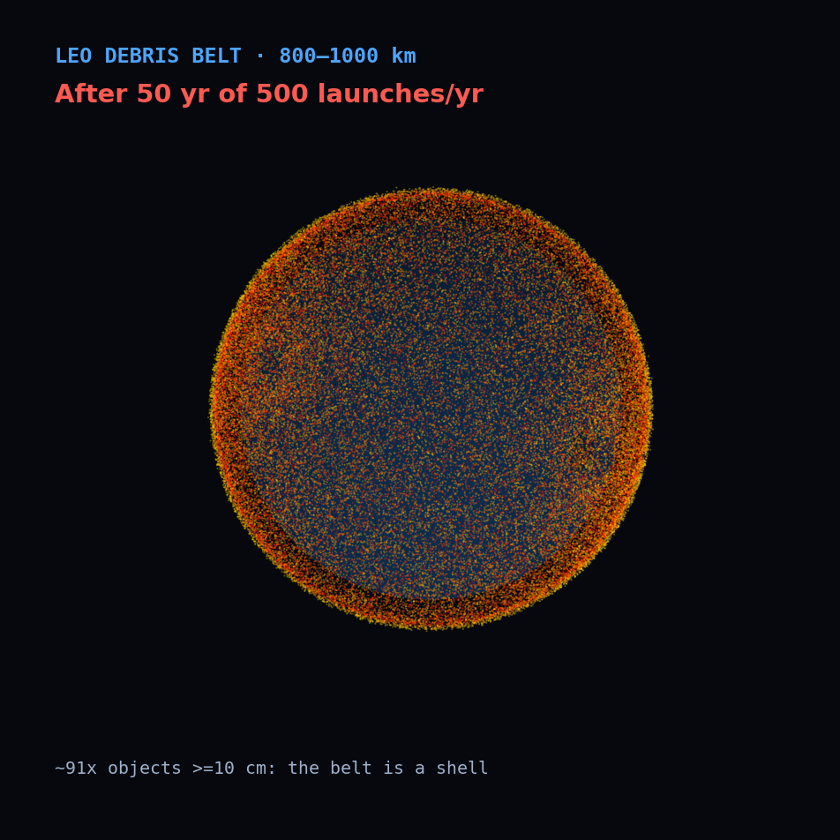
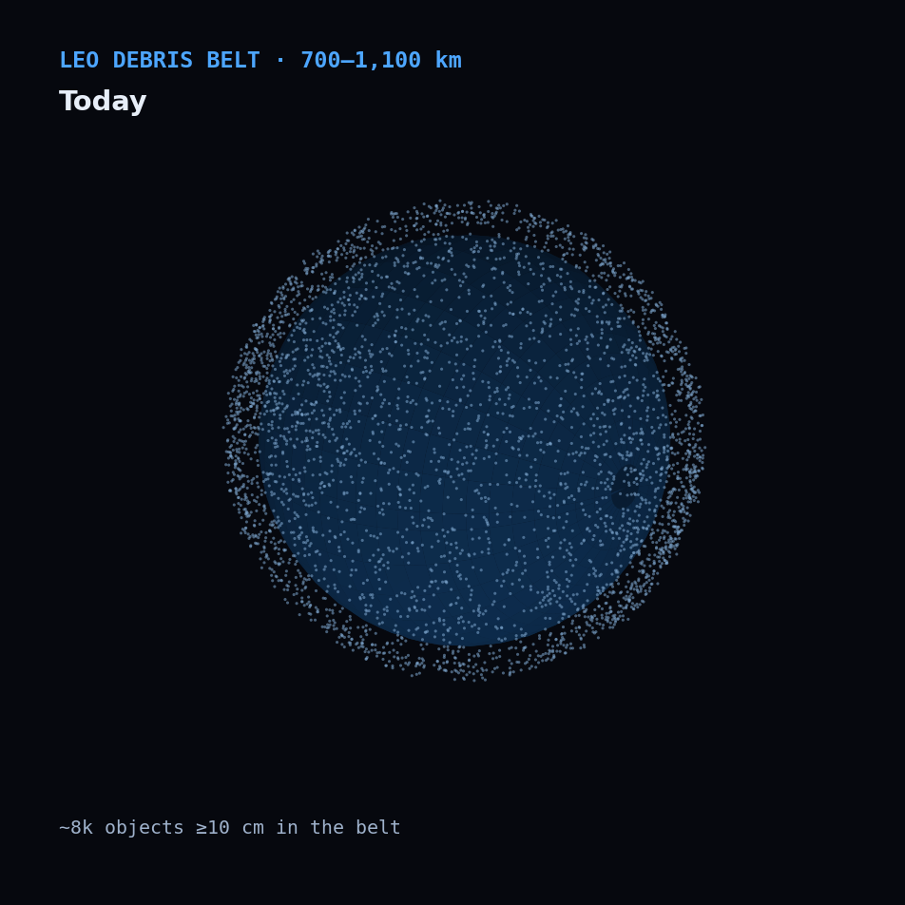



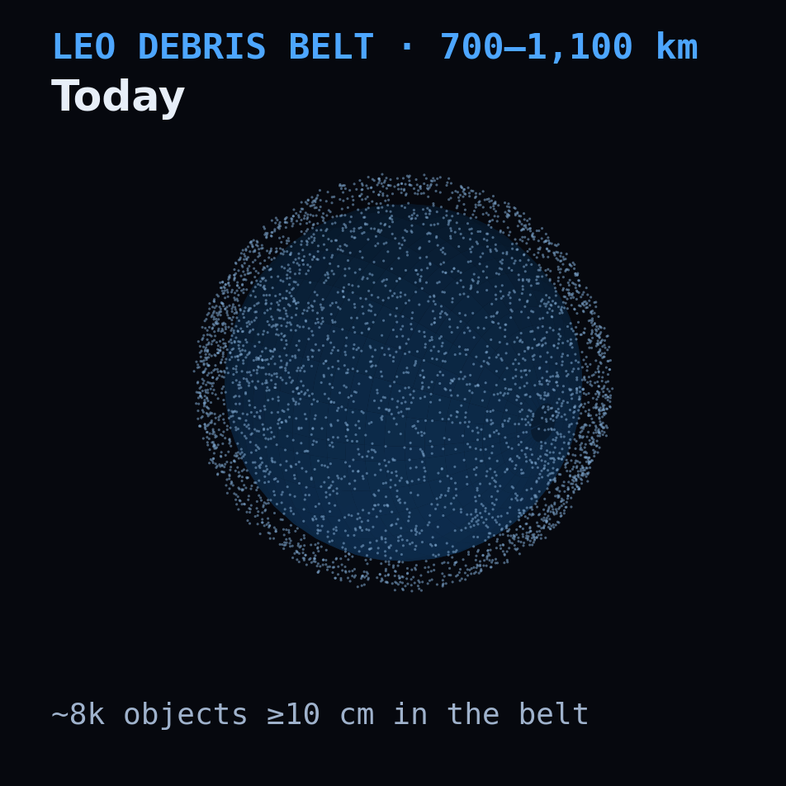
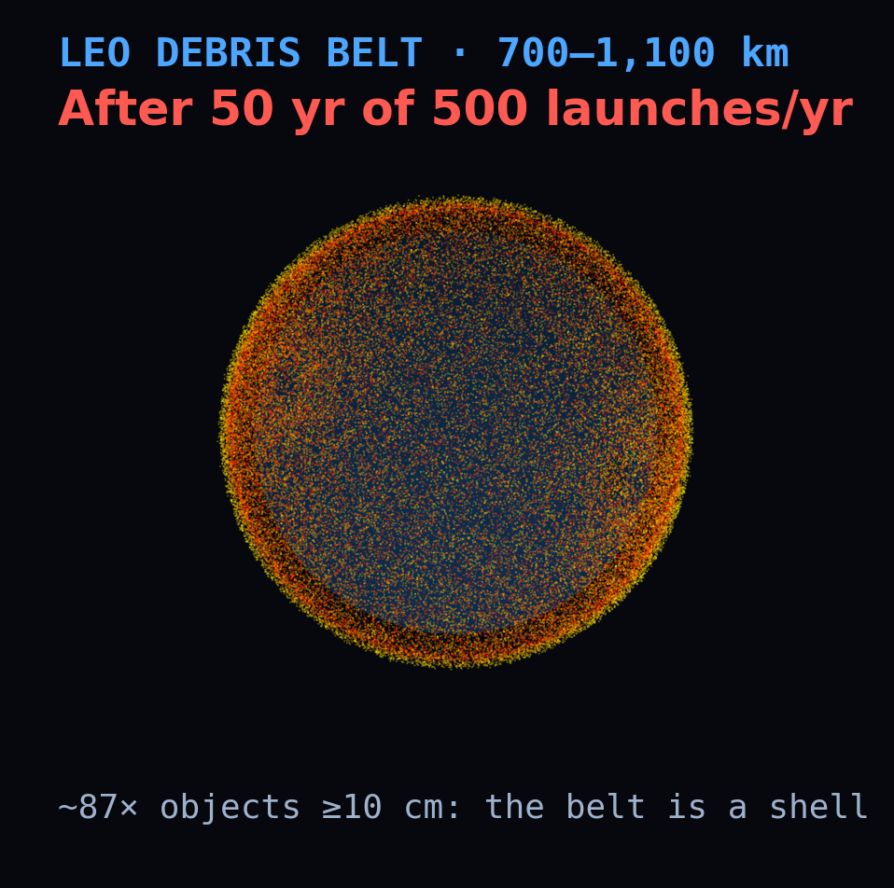
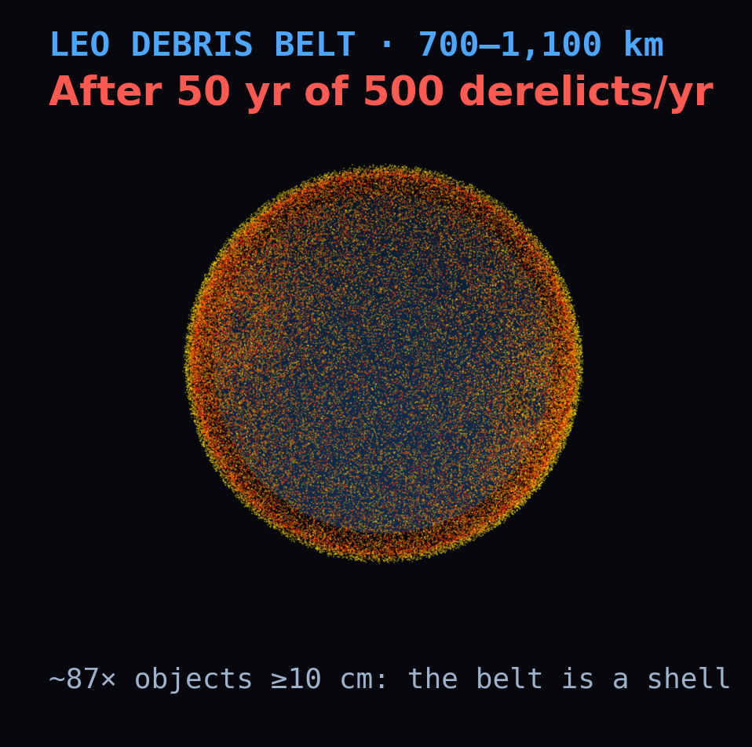
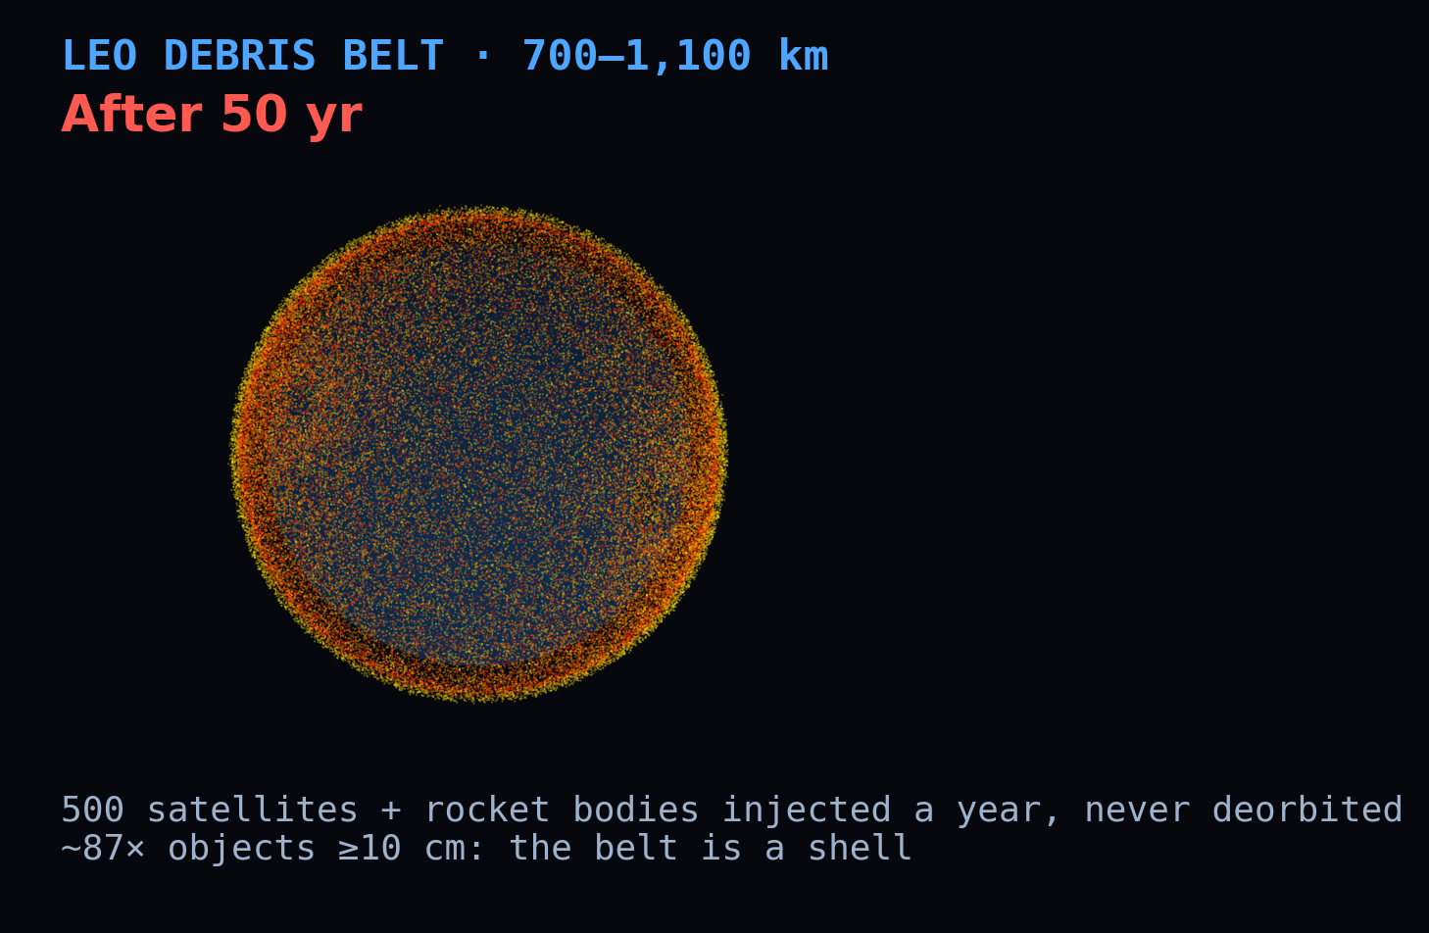


THE DRIVER · ORBIT VISUALIZATION
500 satellites and rocket bodies a year fill the belt
Injecting 500 satellites and rocket bodies a year into the 700–1,100 km belt, none ever deorbited, multiplies its ≥10 cm population ~60× in 50 years — from sparse (left) to a near-opaque hazard band (right). Illustrative; densities not to scale.

Slide 12
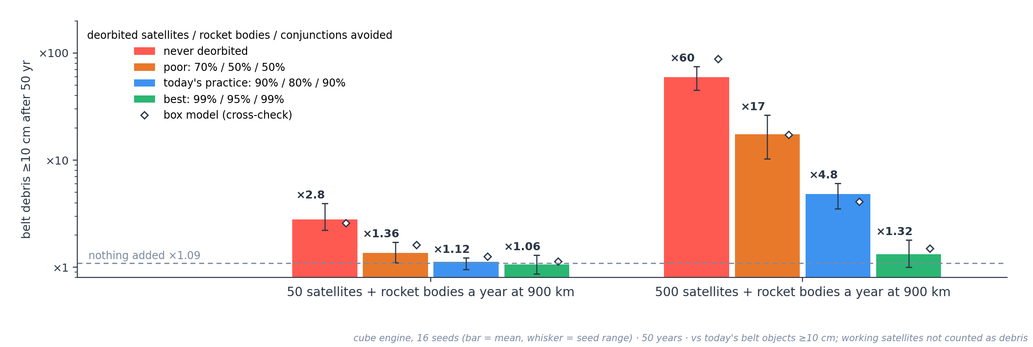
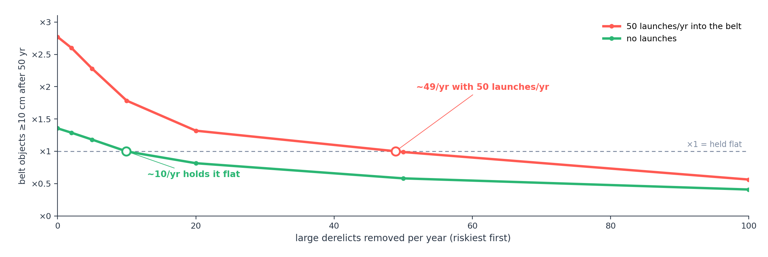
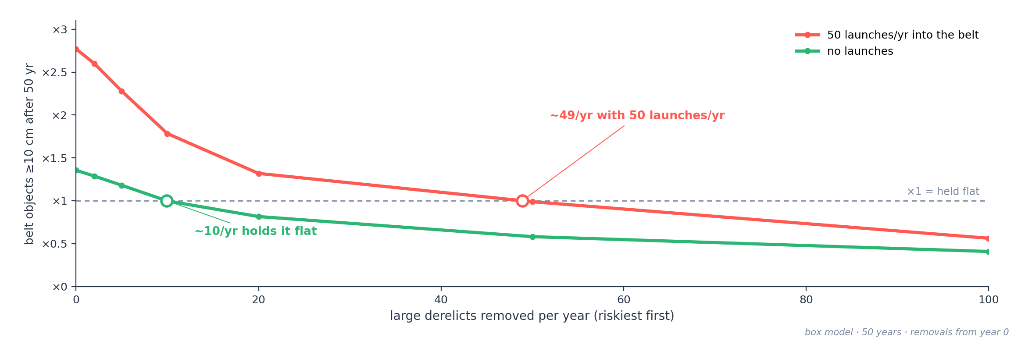




THE LEVER · WORKING SATELLITES
Satellites that deorbit: ×60 becomes ×4.8
Today's practice = most satellites deorbited, most conjunctions dodged.
Same traffic as the extreme case, but each satellite works for 5 years, holding its orbit and dodging tracked (≥10 cm) objects, and is then deorbited. Today's practice: 90% of satellites deorbited (the NASA/FCC/IADC benchmark; SpaceX reports over 99%), 80% of rocket bodies (ESA 2025), 90% of conjunctions avoided by the 89% that can manoeuvre (McDowell 2026). Nothing dodges 1–10 cm debris, and a hit there leaves a dead satellite. What remains comes mostly from failed disposals: at 500 a year, disposal alone gives ×5.3, avoidance alone ×54. Cube engine, 16 seeds (×3.5–×6.1); box model ×4.1.

Slide 13


THE REMEDY
Remove ~9 large dead objects a year and the belt holds flat
Remedy = remove the riskiest large dead objects, and make old stages safe.
Taking out the riskiest large objects each year — the heaviest, in the densest shells (NASA LEGEND's criterion) — bends the belt: ~9 a year holds its ≥10 cm population flat with nothing added. If old stages are also made safe so they can't explode, the belt stays flat without any removals (×1.00 in 50 years; LEGEND: ~5 removals a year). With 50 satellites and rocket bodies a year injected (never deorbited) it takes ~57. Cube engine, 16 seeds; cross-check at 10/yr: box ×0.99, discrete ×1.07. The belt isn't doomed; it's a maintenance problem.

Slide 14

CONGESTION & MEGA-CONSTELLATIONS
A present burden, a future hazard
Now — operational
Ahead — systemic
1,000,000+
satellites filed with regulators — SpaceX up to 1M, China ~200k, mostly on paper. The Kessler risk = scale × altitude × disposal compliance.
~16,800 active satellites (11,100 of them Starlink). Starlink alone made ~207,000 collision-avoidance manoeuvres in six months (Dec 2025 – May 2026) — and there is still no international traffic-management authority.
Same split as everything else: at 550 km the giant fleets self-clean — a burden. At 1,000–1,200 km that mass persists for centuries — the real systemic hazard.

Slide 15
ADDED ELEMENT · THE DEBATE
Two loud claims — both wrong
Why ask: a barrel is the cheapest way to put a debris weapon in orbit — no guidance, no interceptor, just mass and a dispenser. It deserves a number, not an opinion.
CLAIM A — FALSE
CLAIM B — FALSE
“It will do no harm”
“It renders LEO unusable”
Every nail is a lethal, satellite-killing projectile, and a barrel adds a persistent debris population. Harmless it is not.
One barrel never triggers a runaway. Low down, drag clears it in a couple of years; at 900 km, no number of barrels doubles the ≥10 cm belt.
The truth is quantitative — it depends almost entirely on altitude, and it only means something when compared with ordinary traffic.

Slide 16

ADDED ELEMENT · A BARREL OF NAILS
One barrel of nails, defined
The projectile
The deployment
Steel nail | 75 × 3 mm
Mass each | 4.16 g
Tumbling cross-section | 1.8 cm²
Count in a barrel | 200,000
Total launched mass | 832 kg
Released as a random dump — each nail gets a small random Δv, no targeting. The least-hostile way to spread a barrel.
Placed at a chosen altitude and inclination (default 550 km / 53°), then set loose in the real catalog + a modelled 1–10 cm debris field.
Measured: single-nail lethality · drag lifetime · collision flux · a 50-year cascade in three engines · usability by altitude.

Slide 17
ADDED ELEMENT · THE PHYSICS
A single nail: lethal, but no satellite-destroyer
Impact @ 10 km/s | Energy | Catastrophic? | Result
4 g nail → 260 kg sat | 208 kJ | No · 0.8 J/g | Mission-kill + ~140 frags
4 g nail → 3 kg cubesat | 208 kJ | Yes · 69 J/g | Shattered · ~600 frags
260 kg → 260 kg sat | 13 GJ | Yes, deeply | ~29,000 frags
40 J/g
the catastrophic-fragmentation line. A nail against a Starlink lands at 0.8 J/g — 50× too low.
A nail mission-kills whatever it hits, but to shatter a 260 kg satellite you'd need a ~200 g bolt, not a nail. The huge fragment clouds come from large-on-large collisions.

Slide 18
01
Nails mission-kill satellites, leaving dead hulks and cratering debris behind.
ADDED ELEMENT · THE CASCADE
Accelerant,
not igniter
02
That extra mass raises the standing density in the shell.
A barrel can't start Kessler by itself — nails are too light to shatter big objects. What it does is slightly raise the odds of the large-on-large collisions that already drive the belt.
03
But the push is weak: even 1,000 barrels add only ~25% to the ≥10 cm belt in 50 years.

Slide 19






ADDED ELEMENT · ORBIT VISUALIZATION
The nail cloud spreads, then rains out
Left → right: a tight ring at release, spread into a shell by differential precession, then decaying under atmospheric drag — ~46% remain after ~1.5 years at 550 km. Model output, 200,000 nails, J2 + drag.

Slide 20
ADDED ELEMENT · THE SCALE CHECK
How many barrels to tip a band?
~ +25%
90–230
≈ 22
1,000 barrels, ≥10 cm belt
barrels double the 1–10 cm field
barrels ≈ one ASAT, ≥10 cm belt
Barrels dumped at 900 km, over 50 years, compared with the same run without them. Nails flood the lethal-but-untrackable 1–10 cm field but barely feed the ≥10 cm cascade: the belt reaches +21% above the no-barrel run at 300 barrels and +25% at 1,000 — flattening, never doubling. The 90–230 range brackets how much debris small impacts throw off (breakup model as written vs NASA's LEGEND convention).

Slide 21



ADDED ELEMENTS · FOR COMPARISON
Every source on one measure
Same measure = extra objects in the belt, for every source.
Extra ≥10 cm objects in the 700–1,100 km belt after 50 years, compared with adding nothing. One barrel adds ~17, an ASAT strike ~360, and 1,000 barrels ~2,500. Injecting 50 satellites and rocket bodies a year that are never deorbited adds ~14,000, 5.5× that. Traffic, not the barrel, is what moves the belt.

Slide 22







ADDED ELEMENT · A LOW BREAKUP
Low down, even a big breakup clears fast
Extra collision risk at 475 km after a 2.2 t breakup (like Cosmos-1408)
+16%
local collision risk at the peak — not a no-go zone
~1 yr
for drag to sweep it clean
Trigger: a large low-altitude fragmentation — an ASAT strike or a big collision.
The same debris at 900 km would linger for centuries. Low LEO forgives — the high belt does not.

Slide 23
THE VERDICT
Low-Earth orbit stays usable if what goes up comes down.
What decides it: mass left in the 700–1,100 km belt without disposal. Deorbit 90% of satellites at end of life and even 500 a year grows the belt ×4.8, not ×60; remove about nine large dead objects a year and it holds flat.
Added elements: a missile strike adds ~360 objects ≥10 cm; a barrel of nails kills satellites, but even 1,000 barrels add only ~2,500 (+25%).

Slide 24





HONEST ABOUT ITSELF
What the model can and can't say
Three engines agree
Main uncertainties
Not modelled
With nothing added, the belt's ≥10 cm population grows in all three: cube ×1.09 (16 seeds), box ×1.21, discrete ×1.21. Single cube runs span ×0.86–×1.40.
Disposal reliability sets the traffic outcome: at 500 a year, ×1.32 to ×17. Explosions set the no-launch baseline, ×1.00 to ×1.58. Cratering changes 1–10 cm results 2–3×, not the ≥10 cm belt.
Degradation debris. The solar cycle (tested in the 2006 benchmark, not in the headline runs). Satellites dodge and deorbit only in the working-satellite case; elsewhere added objects stay dead.
Checked against NASA: the 2006 benchmark
NASA's LEGEND study (Liou & Johnson 2006), rerun from the same 1 Jan 2006 catalog: no launches or explosions, 200 years, ≥10 cm objects only. LEGEND: 10.8 catastrophic collisions, ~60% at 900–1,000 km, LEO flat for ~50 years. Cube engine: 12.8 (7–18 over 16 seeds), ~46% there, +13% at 50 years; box model 9.9 and +15%. Removals: ~9 large objects a year hold the belt flat; with explosions prevented it stays flat on its own (LEGEND: ~5).
CelesTrak + Space-Track · NASA breakup model · RTX 5090 / CUDA

Slide 25
SOURCES & REFERENCES
Data, models, and literature
Catalog data
Models & methods
Space-Track.org — full on-orbit GP catalog & SATCAT (RCS)
CelesTrak — GP / TLE catalog & SATCAT
NASA Standard Breakup Model — Johnson et al. (2001), Adv. Space Res.
Cube method / LEGEND — Liou (2003)
WGS-72 / J2
Krisko (2011), NASA ODQN 15(4) — implementing the breakup model
Foundational literature
Kessler & Cour-Palais (1978), J. Geophys. Res. — the debris belt
Liou & Johnson (2006), Science — growth without launches
Liou, Johnson & Hill (2010), Acta Astronautica — active removal
Liou (2011), Adv. Space Res. — removing ~5 objects a year
IADC comparison study (2013) — stability of future LEO
Events & policy
Fengyun-1C (2007), Cosmos–Iridium (2009), Cosmos-1408 (2021)
Outer Space Treaty (1967); UN Space Debris Mitigation Guidelines (2007); PAROS / PPWT
McDowell, Jonathan's Space Report (active satellites, Sep 2026); Pultarova, Space.com (Jul 2026) — Starlink manoeuvres, from SpaceX's FCC filing
Charts are DebrisCascade model outputs on the live Space-Track catalog; orbit visualizations are illustrative. Values are order-of-magnitude estimates from a stylised model — not operational predictions.

